Slide 1
Software Testing and validation

Slide 2
What is Software Testing?
Several definitions:
“Testing is the process of establishing confidence that a program or system does what it is supposed to.” by Hetzel 1973
“Testing is the process of executing a program or system with the intent of finding errors.” by Myers 1979
“Testing is any activity aimed at evaluating an attribute or capability of a program or system and determining that it meets its required results.” by Hetzel 1983

Slide 3
What is Software Testing?
- One of very important software development phases
- A software process based on well-defined software quality control and testing standards, testing methods, strategy, test criteria, and tools.
- Engineers perform all types of software testing activities to perform a software test process.
- The last quality checking point for software on its production line

Slide 4
Who does Software Testing?
- Test manager
- manage and control a software test project
- supervise test engineers
- define and specify a test plan
- Software Test Engineers and Testers
- define test cases, write test specifications, run tests
- Independent Test Group
- Development Engineers
- Only perform unit tests and integration tests
- Quality Assurance Group and Engineers
- Perform system testing
- Define software testing standards and quality control process

Slide 5

The Test Plan
The Test Plan
    who
    what
    when
    where
    how

Slide 6
Test Plan Considerations
What are the critical or most complex modules?
    make sure they get integration tested first
    probably deserve white-box attention
Where have you had problems in the past?
Third-Party delivered components?
What training is required?
    conducting formal reviews
    use of testing tools
    defect report logging

Slide 7
IEEE 829 - Standard for
Software Test Documentation
Recommends 8 types of testing documents:
Test Plan
    next slide
Test Design Specification
    expected results, pass criteria, ...
Test Case Specification
    test data for use in running the tests
Test Procedure Specification
    how to run each test
Test Item Transmittal Report
    reporting on when components have progressed from one stage of testing to the next
Test Log
Test Incident Report
    for any test that failed, the actual versus expected result
Test Summary Report
    management report
http://en.wikipedia.org/wiki/IEEE_829

Slide 8
Test Plan Contents (IEEE 829 format)
Test Plan Identifier
References
Introduction
Test Items
    see next slide
Software Risk Issues
Features to be Tested
Features not to be Tested
Approach
Item Pass/Fail Criteria
Suspension Criteria and Resumption Requirements
Test Deliverables
Remaining Test Tasks
Environmental Needs
Staffing and Training Needs
Responsibilities
Schedule
Planning Risks and Contingencies
Approvals
Glossary
http://en.wikipedia.org/wiki/Test_Plan

Slide 9
Test Items
Requirements Specification
Design
Modules
User/Operator Material
    the user interface
    User Guide
    Operations Guide
Features
    response time, data accuracy, security, etc
System Validation
    alpha and beta testing
Based on IEEE 829

Slide 10
Reality Check
When is more testing not cost effective?
SQA
+
Failure
SAR
Cost of SQA
Cost of Failure
Software Quality Assurance Activities
Optimal Quality Level

Slide 11
Testing
Apply input
Observe output
Software
Oracle
Validate the observed output against the expected output
Is the observed output the same as the expected output?

Slide 12
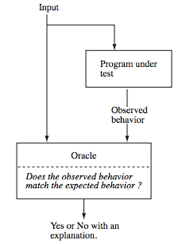
Oracle: Examples
How to verify the output of a matrix multiplication?
How to verify the output of a matrix inversion program?
How to verify the output of a sorting algorithm?
© Aditya P. Mathur 2009

Slide 13
Oracle: Example
A tester often assumes the role of an oracle and thus serves as human oracle.
How to verify the output of a matrix multiplication?
Hand calculation: the tester might input two matrices and check if the output of the program matches the results of hand calculation.
Oracles can also be programs. For example, one might use a matrix multiplication to check if a matrix inversion program has produced the correct result: A × A⁻¹ = I
How to verify the output of a sorting algorithm?
© Aditya P. Mathur 2009

Slide 14
Oracle: Construction
Construction of automated oracles, such as the one to check a matrix multiplication program or a sort program, requires the determination of input-output relationship.
In general, the construction of automated oracles is a
complex undertaking.

Slide 15
Limitations of Testing
Dijkstra, 1972
  Testing can be used to show the presence of bugs, but never their absence
Goodenough and Gerhart, 1975
  Testing is successful if the program fails
The (modest) goal of testing
  Testing cannot guarantee the correctness of software but can be effectively used to find errors (of certain types)

Slide 16
Software Testing Principles
Principle #1: Complete testing is impossible.
Principle #2: Software testing is not simple activity.
  Reasons:
    Quality testing requires testers to understand a system/product completely
    Quality testing needs adequate test set, and efficient testing methods
    A very tight schedule and lack of test tools.
Principle #3: Testing is risk-based.
Principle #4: Testing must be planned.
Principle #5: Testing requires independence (SQA team).
Principle #6: Quality software testing depends on:
    Good understanding of software products and related domain application
    Cost-effective testing methodology, coverage, test methods, and tools.
    Good engineers with creativity, and solid software testing experience

Slide 17
Fundamental Questions in Testing
When can we stop testing?
  Test coverage
What should we test?
  Test generation
Is the observed output correct?
  Test oracle
How well did we do?
  Test efficiency
Who should test your program?
  Independent V&V

Slide 18
Software Testing Process
V&V Targets
Unit test
Code & Implementation
Integration
test
Software Design
Validation
test
Requirements
System
test
System engineering

Slide 19
Testing Process Goals
Validation testing
  To demonstrate to the developer and the system customer that the software meets its requirements;
  A successful test shows that the system operates as intended.
Verification – Defect testing
  To discover faults or defects in the software where its behavior is incorrect or not in conformance with its specification;
  A successful test is a test that makes the system perform incorrectly and so exposes a defect in the system.

Slide 20
Levels of Testing
Component/Unit testing
Integration testing
System testing
Acceptance testing
Regression testing

Slide 21
Levels of Testing
What users
really need
Acceptance testing
Requirements
System testing
Design
Integration testing
Code
Unit testing
Maintenance
Regression Testing

Slide 22
COMPONENT/UNIT TESTING
Software Testing Process

Slide 23
Component Testing
Testing of individual program components;
Usually the responsibility of the component developer (except sometimes for critical systems);
Tests are derived from the developer’s experience.
Require knowledge of code
  High level of detail
  Deliver thoroughly tested components to integration
Stopping criteria
  Code Coverage
  Quality

Slide 24
Component Testing
Test case
  Input, expected outcome, purpose
  Selected according to a strategy, e.g., branch coverage
Outcome
  Pass/fail result
  Log, i.e., chronological list of events from execution

Slide 25
INTEGRATION TESTING
Software Testing Process

Slide 26
Integration Testing
Test assembled components
  These must be tested and accepted previously
Focus on interfaces
  Might be interface problem although components work when tested in isolation
  Might be possible to perform new tests

Slide 27
Integration Testing
Strategies
  Bottom-up, start from bottom and add one at a time
  Top-down, start from top and add one at a time
  Big-bang, everything at once
  Functional, order based on execution
Simulation of other components
  Stubs receive output from test objects
  Drivers generate input to test objects
  Note that these are also SW, i.e., need testing etc.

Slide 28



Integration Testing
There are two groups of software integration strategies:
- Non Incremental software integration
- Incremental software integration
Non Incremental software integration:
Big bang integration approach
Incremental software integration:
Top- down software integration
Bottom-up software integration
Sandwich integration

Slide 29
Integration Testing
Involves building a system from its components and testing it for problems that arise from component interactions.
Top-down integration
  Develop the skeleton of the system and populate it with components. Use stubs to replace real components.
  Two strategies: depth first and breadth first.
Bottom-up integration
  Integrate infrastructure components then add functional components. Use drivers to test components
To simplify error localisation, systems should be incrementally integrated.

Slide 30
SYSTEM TESTING
Software Testing Process

Slide 31
System Testing
Testing of groups of components integrated to create a system or sub-system;
The responsibility of an independent testing team;
Tests are based on a system specification.

Slide 32
System Testing
Functional testing
  Test end to end functionality
  Requirement focus
    Test cases derived from specification
  Use-case focus
    Test selection based on user profile

Slide 33
System Testing
Non-functional testing
Quality attributes
  Performance, can the system handle required throughput?
  Reliability, obtain confidence that system is reliable
  Timeliness, testing whether the individual tasks meet their specified deadlines
  etc.

Slide 34
ACCEPTANCE TESTING
Software Testing Process

Slide 35
Acceptance Testing
User (or customer) involved
Environment as close to field use as possible
Focus on:
  Building confidence
  Compliance with defined acceptance criteria in the contract

Slide 36
REGRESSION TESTING
Software Testing Process

Slide 37
Re-Test and Regression Testing
Conducted after a change
Re-test aims to verify whether a fault is removed
  Re-run the test that revealed the fault
Regression test aims to verify whether new faults are introduced
  How can we test modified or newly inserted programs?
    Ignore old test suites and make new ones from the scratch or
    Reuse old test suites and reduce the number of new test suites as many as possible
  Should preferably be automated

Slide 38
TEST STRATEGIES
Software Testing Process

Slide 39
Strategies
Code coverage strategies, e.g.
  Decision coverage
  Path coverage
  Data-Flow analysis (Defines -> Uses)
Specification-based testing, e.g.
  Equivalence partitioning
  Boundary-value analysis
  Combination strategies
State-based testing

Slide 40
Test Strategies
Black-box or behavioral testing
  knowing the specified function a product is to perform and demonstrating correct operation based solely on its specification without regard for its internal logic
White-box or glass-box testing
  knowing the internal workings of a product, tests are performed to check the workings of all possible logic paths

Slide 41
Code Coverage
Statement coverage
  Each statement should be executed by at least one test case
  Minimum requirement
Branch/Decision coverage
  All paths should be executed by at least one test case
  All decisions with true and false value

Slide 42
Mutation testing
Create a number of mutants, i.e., faulty versions of program
  Each mutant contains one fault
  Fault created by using mutant operators
Run test on the mutants (random or selected)
  When a test case reveals a fault, save test case and remove mutant from the set, i.e., it is killed
  Continue until all mutants are killed
Results in a set of test cases with high quality
Need for automation

Slide 43
Mutation Testing
Mutants
int getMax(int x, int y) { int getMax(int x, int y) {
int max; int max;
if (x >y) if (x >=y)
max = x; max = x;
else else
max = y; max = y;
return max; return max;
} }
int getMax(int x, int y) {
int max;
if (x >y)
max = x;
else
max = x;
return max;
}

Slide 44
Examples of Mutant Operators
Mutant operator | In program | In mutant
Variable replacement | z=x*y+1; | x=x*y+1; z=x*x+1;
Relational operator replacement | if (x<y) | if(x>y) if(x<=y)
Off-by-1 | z=x*y+1; | z=x*(y+1)+1; z=(x+1)*y+1;
Replacement by 0 | z=x*y+1; | z=0*y+1; z=0;
Arithmetic operator replacement | z=x*y+1; | z=x*y-1; z=x+y-1;

Slide 45
Specification-based testing
Test cases derived from specification
Equivalence partitioning
  Identify sets of input from specification
    Assumption: if one input from set s leads to a failure, then all inputs from set s will lead to the same failure
  Chose a representative value from each set
  Form test cases with the chosen values

Slide 46
Specification-Based Testing
Expected output
Specification
Apply input
Actual output
Program
Validate the observed output against the expected output

Slide 47
Black Box testing
Equivalence Partitioning
Input data and output results often fall into different classes where all members of a class are related.
Each of these classes is an equivalence partition or domain where the program behaves in an equivalent way for each class member.
Test cases should be chosen from each partition.

Slide 48
Equivalence Partitioning
Black-box technique divides the input domain into classes of data from which test cases can be derived.
An ideal test case uncovers a class of errors that might require many arbitrary test cases to be executed before a general error is observed.

Slide 49
Specification-based testing
Boundary value analysis
  Identify boundaries in input and output
  For each boundary:
    Select one value from each side of boundary (as close as possible)
  Form test cases with the chosen values

Slide 50
Boundary Value Analysis
Black-box technique
  focuses on classes and also on the boundaries of the input domain.
Guidelines:
  If input condition specifies a range bounded by values a and b, test cases should include a and b, values just above and just below a and b
  If an input condition specifies a number of values, test cases should exercise the minimum and maximum numbers, as well as values just above and just below the minimum and maximum values

Slide 51
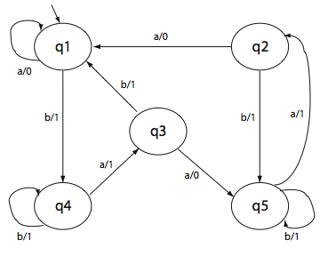
State-Based Testing
Model functional behavior in a state machine (communication – protocol …)
Select test cases in order to cover the graph
  Each node
  Each transition
  Each pair of transitions
  Each chain of transitions of length n

Slide 52


Example:
Factorial function: n!
Factorial
n
n!

Slide 53
Factorial of n: n!
Equivalence partitioning – break the input domain into different classes:
  Class1: n<0
  Class2: n>0 and n! doesn’t cause an overflow
  Class3: n>0 and n! causes an overflow
Boundary Value Analysis:
  n=0 (between class1 and class2)

Slide 54
Factorial of n: n!
Test cases
Test case = ( ins, expected outs)
Equivalence partitioning – break the input domain into different classes:
  From Class1: ((n = -1), “ function not defined for n negative”)
  From Class2: ((n = 3), 6)
  From Class3: ((n=100), “ input value too big”)
Boundary Value Analysis:
  ((n=0), 1)

Slide 55
Test Strategies
White-Box Testing
Structural Testing

Slide 56
White Box testing
Structural Testing
The objective of path testing is to ensure that the set of test cases is such that each path through the program is executed at least once.
The starting point for path testing is a program flow graph that shows nodes representing program decisions and arcs representing the flow of control.
Statements with conditions are therefore nodes in the flow graph.

Slide 57
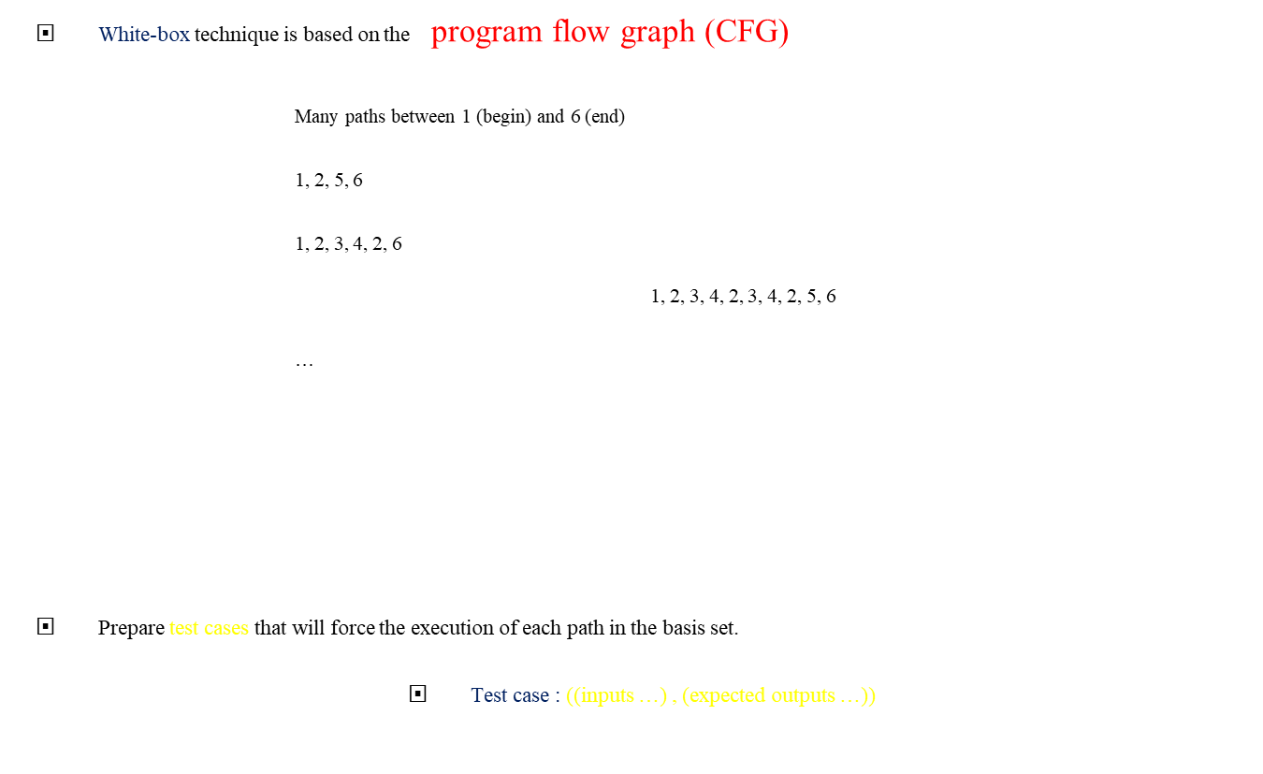
Path testing – Control Flow Graph
1
2
3
4
5
6

Slide 58
Program flow graph
Basic Control Flow Graphs
1
1
2
1
1
2
3
2
3
2
3
4
4
4
5
A sequence:
X = 1;
Y = X * 10;
If condition:
If … Then
…
Else
…
End if
5
Do While loop (Repeat until):
do
…
statements
…
While …
While loop:
While … do
…
statements
…
End while

Slide 59
Example:
Binary search pseudo-code

Slide 60
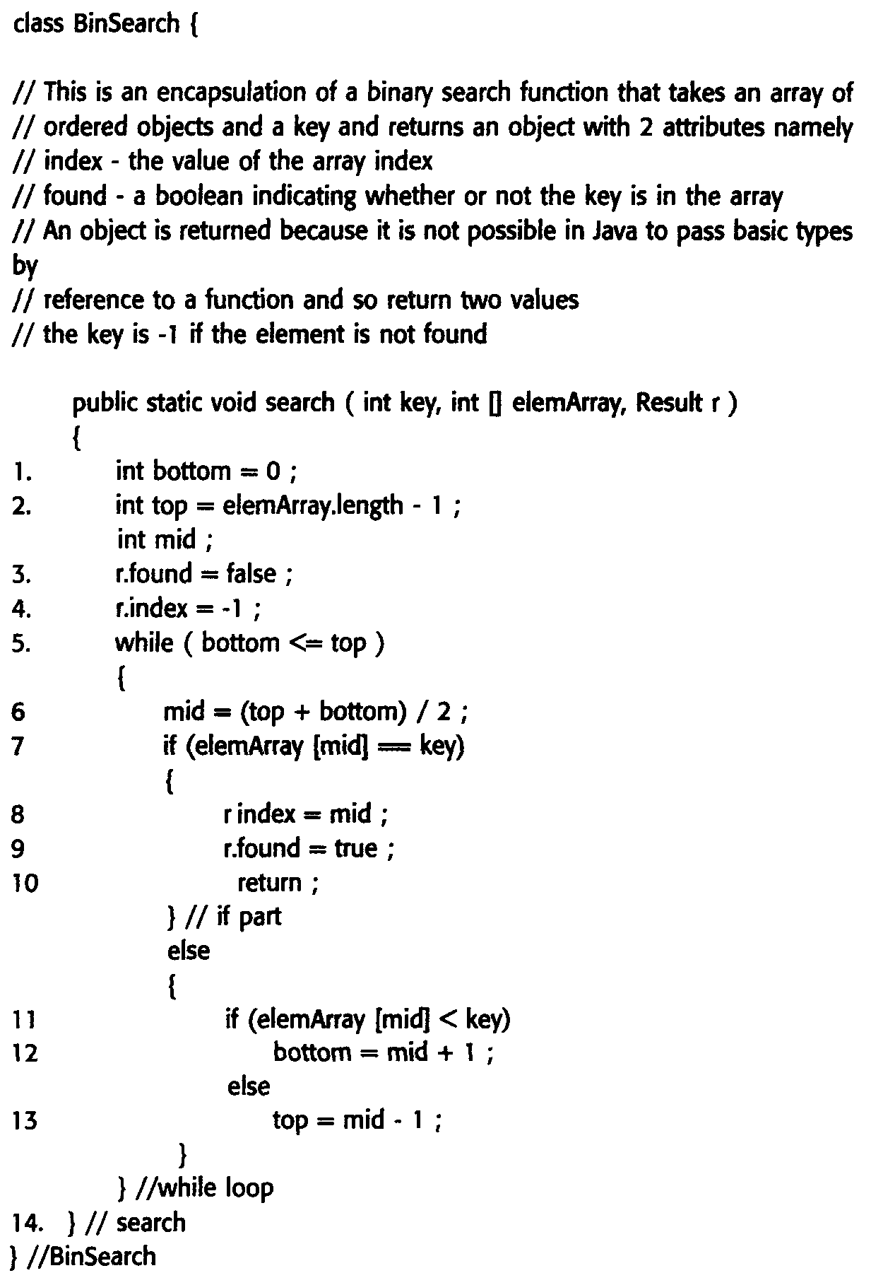

Slide 61
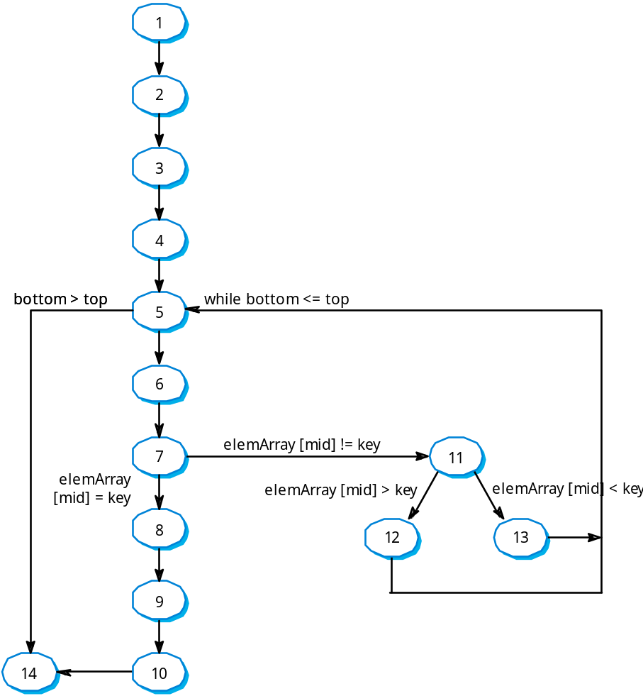
Binary search flow graph

Slide 62
Independent Paths
1, 2, 3, 4, 5, 6, 7, 8, 9, 10, 14
1, 2, 3, 4, 5, 14
1, 2, 3, 4, 5, 6, 7, 11, 12, 5, …
1, 2, 3, 4, 6, 7, 2, 11, 13, 5, …
Test cases should be derived so that all of these paths are executed

Slide 63
Software Metrics
McCabe’s cyclomatic number, introduced in 1976, is, after lines of code, one of the most commonly used metrics in software development.
The cyclomatic complexity of the program is computed from its control flow graph (CFG) using the formula:
V(G) = Edges – Nodes + 2
or by counting the conditional statements and adding 1
This measure determines the basis set of linearly independent paths and tries to measure the complexity of a program

Slide 64
Software Metrics
V(G) = Edges – Nodes + 2
V(G) = 6 – 6 + 2 = 2
V(G) = conditional statements + 1
= 1 + 1 = 2
Two linearly independent paths:
1, 2, 5, 6
1, 2, 3, 4, 2, 5, 6
1
2
3
4
5
6

Slide 65
Software Metrics
V(G) = Edges – Nodes + 2
V(G) = 16 – 14 + 2 = 4
V(G) = # regions = 4
V(G) = conditional statements + 1
= 3 + 1 = 4
four linearly independent paths

Slide 66
References
K. NAIK AND P. TRIPATHY: “SOFTWARE TESTING AND QUALITY ASSURANCE”, WILEY, 2008.
IAN SOMMERVILLE, SOFTWARE ENGINEERING, 8TH EDITION, 2006.
ADITYA P. MATHUR,“FOUNDATIONS OF SOFTWARE TESTING”, PEARSON EDUCATION, 2009.
D. GALIN, “SOFTWARE QUALITY ASSURANCE: FROM THEORY TO IMPLEMENTATION”, PEARSON EDUCATION, 2004
DAVID GUSTAFSON, “THEORY AND PROBLEMS OF SOFTWARE ENGINEERING”, Schaum’s Outline Series, McGRAW-HILL, 2002.

